Slide 1
Learning Objective
I will use the unit circle to determine sine, cosine and tangent values
Success Criteria
At the end of the lesson, I will be able to:
Determine the sine, cosine and tangent of angles using Unit Circle
Determine the exact value of sine, cosine and tangent angles

Slide 2




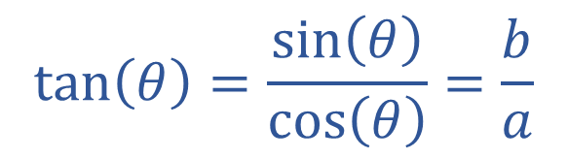


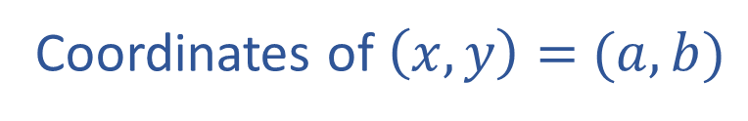

Skill Development
Unit Circle
$$y$$
Determine $cos\left(θ\right)\text{, }\sin\left(θ\right)\text{and}\tan\left(θ\right)$ in terms of $a, b$.
$$(a,b)$$
Coordinates of $\left(x,y\right)=$ $(a,b)$
$$\left(x,y\right)=(\cos\left(θ\right),\sin\left(θ\right))$$
$$θ°$$
$$\cos{(θ)}=a$$
$$sin\left(θ\right)=b$$
0
$$x$$
$$\tan\left(θ\right)=\frac{\sin\left(θ\right)}{\cos\left(θ\right)}=\frac{b}{a}$$

Slide 3

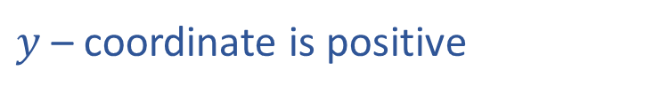


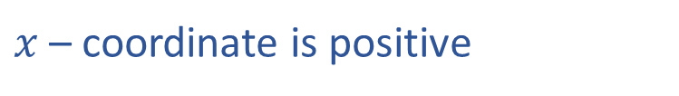



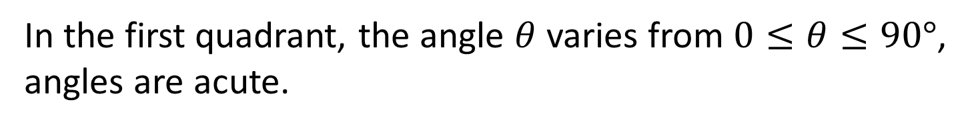
Skill Development
Unit Circle
$$y$$
In the first quadrant, the angle $θ$ varies from $0≤θ≤90°$,
angles are acute.
$$(x,y)$$
Quadrant 1
$x$ – coordinate is positive
$∴\cos{(θ)}$ is positive
$$θ°$$
$y$ – coordinate is positive
0
$$x$$
$∴\sin{(θ)}$ is positive
$\tan\left(θ\right)=\frac{\sin\left(θ\right)}{\cos\left(θ\right)}$ since, both are positive, $tan⁡(θ)$ is positive
In the first quadrant, the angle $θ$ varies from $0≤θ≤90°$, all trig ratios are positive.

Slide 4
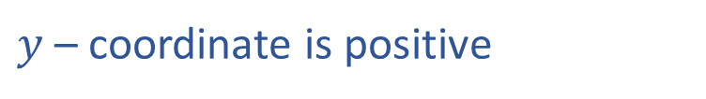

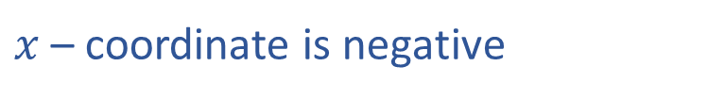

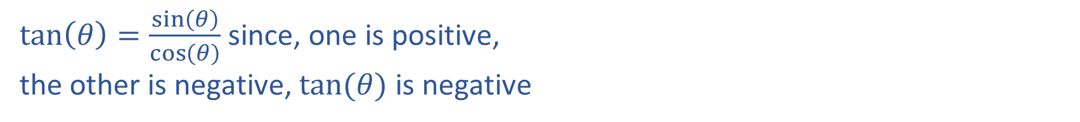

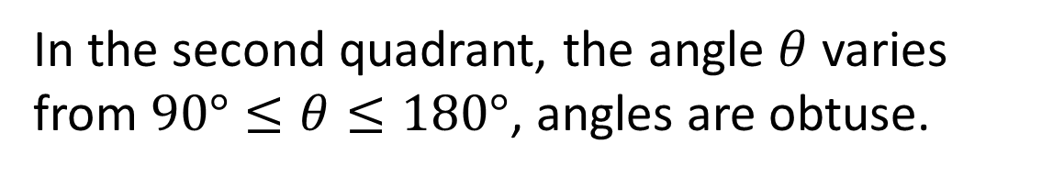
Skill Development
Unit Circle
$$y$$
In the second quadrant, the angle $θ$ varies from $90°≤θ≤180°$, angles are obtuse.
Quadrant 2
$$(x,y)$$
$x$ – coordinate is negative
$∴\cos{(θ)}$ is negative
$y$ – coordinate is positive
0
$$x$$
$∴\sin{(θ)}$ is positive
$\tan\left(θ\right)=\frac{\sin\left(θ\right)}{\cos\left(θ\right)}$ since, one is positive, the other is negative, $tan⁡(θ)$ is negative

Slide 5
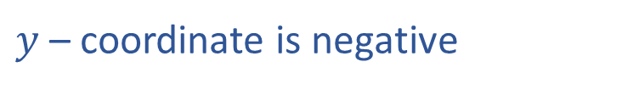

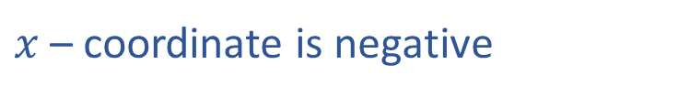


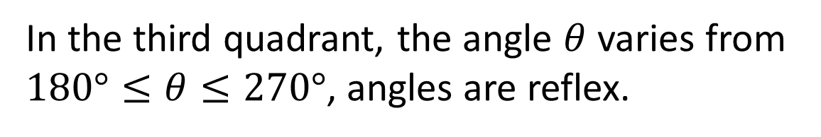
Skill Development
Unit Circle
$$y$$
In the third quadrant, the angle $θ$ varies from $180°≤θ≤270°$, angles are reflex.
$x$ – coordinate is negative
$∴\cos{(θ)}$ is negative
$y$ – coordinate is negative
0
$$x$$
$∴\sin{(θ)}$ is negative
$$(x,y)$$
Quadrant 3
$\tan\left(θ\right)=\frac{\sin\left(θ\right)}{\cos\left(θ\right)}$ since, both are negative, $tan⁡(θ)$ is positive

Slide 6


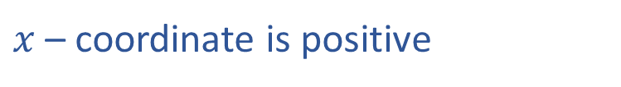

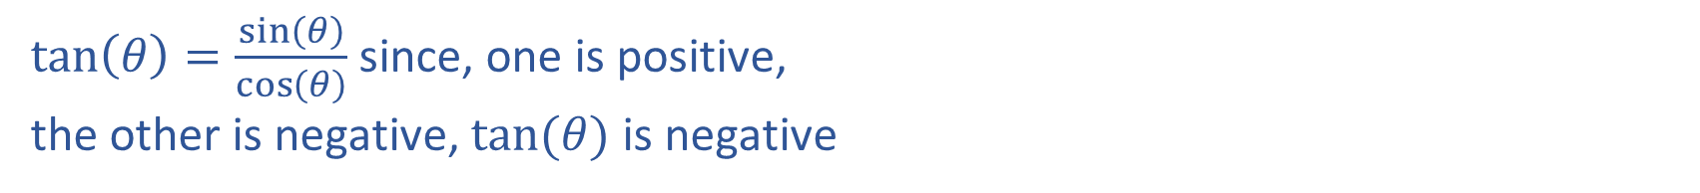

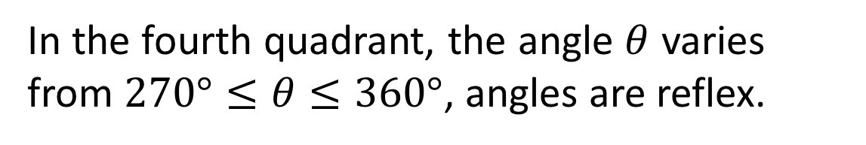
Skill Development
Unit Circle
$$y$$
In the fourth quadrant, the angle $θ$ varies from $270°≤θ≤360°$, angles are reflex.
$x$ – coordinate is positive
$∴\cos{(θ)}$ is positive
0
$$x$$
$y$ – coordinate is negative
$∴\sin{(θ)}$ is negative
Quadrant 4
$\tan\left(θ\right)=\frac{\sin\left(θ\right)}{\cos\left(θ\right)}$ since, one is positive, the other is negative, $tan⁡(θ)$ is negative
$$(x,y)$$

Slide 7






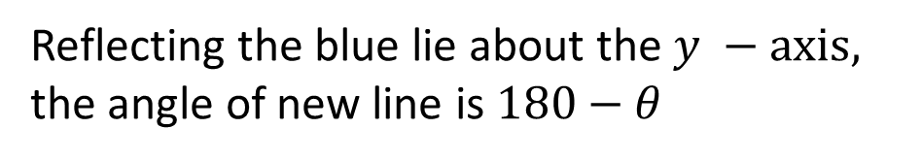
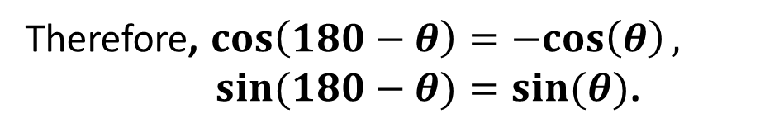



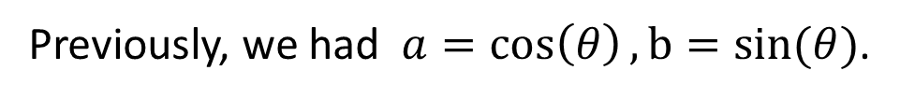


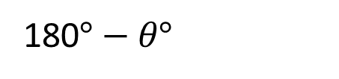
Skill Development
Reflecting the blue lie about the $y −axis,$ the angle of new line is $180−θ$
$$y$$
$$\cos{(180−θ)}=−a ,$$
$$sin\left(180−θ\right)=b$$
$$(−a,b)$$
$$b$$
$$(a,b)$$
Previously, we had $a=\cos\left(θ\right), b=sin(θ)$.
$$θ°$$
$$θ°$$
180$°−θ°$
$$−a$$
0
$$a$$
$$x$$
$$\cos{(180−θ)}=−a=−cos⁡(θ) ,$$
$$sin\left(180−θ\right)=b=sin⁡(θ)$$
Therefore, $cos\left(180−θ\right)=−cos\left(θ\right),$ $sin(180−θ)=sin(θ)$.

Slide 8
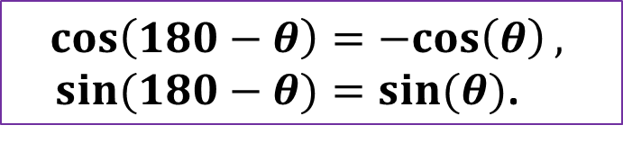







Guided Practice
Express $sin(150°)$in terms of acute angles.
$$y$$
Quadrant 2
Quadrant 1
$$sin\left(150°\right)=\sin\left(180°−150°\right)$$
$$sin\left(150°\right)=\sin\left(30°\right)$$
$$150°$$
$$180°−150°$$
0
$$x$$
Quadrant 3
Quadrant 4
$$cos\left(180−θ\right)=−cos\left(θ\right),$$ $sin(180−θ)=sin(θ)$.

Slide 9




Guided Practice
$$y$$
Express $cos(135°)$in terms of acute angles.
Quadrant 2
Quadrant 1
$$cos\left(135°\right)=−\cos\left(180°−135°\right)$$
$$cos\left(135°\right)=−cos\left(45°\right)$$
$$135°$$
$$180°−135°$$
0
$$x$$
Quadrant 3
Quadrant 4
$$cos\left(180−θ\right)=−cos\left(θ\right),$$ $sin(180−θ)=sin(θ)$.

Slide 10


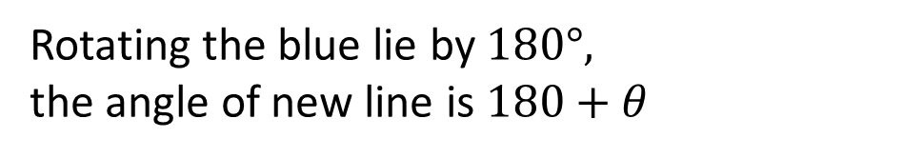


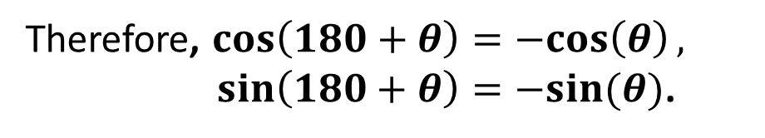

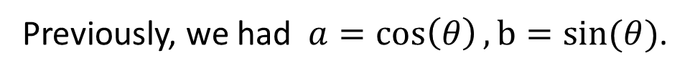



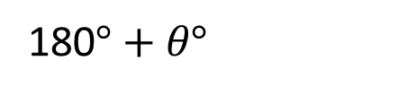



Skill Development
Rotating the blue lie by $180°,$
the angle of new line is $180+θ$
$$y$$
$$\cos{(180+θ)}=−a ,$$
$$sin\left(180+θ\right)=−b$$
$$b$$
$$(a,b)$$
$$y$$
Previously, we had $a=\cos\left(θ\right), b=sin(θ)$.
180$°+θ°$
$$\cos{(180+θ)}=−a=−cos⁡(θ) ,$$
$$x$$
$$−a$$
$$θ°$$
$$sin\left(180+θ\right)=−b=−sin⁡(θ)$$
$$θ°$$
0
$$a$$
$$x$$
$$−b$$
$$(−a,−b)$$
Therefore, $cos\left(180+θ\right)=−cos\left(θ\right),$ $sin\left(180+θ\right)=−sin(θ)$.

Slide 11

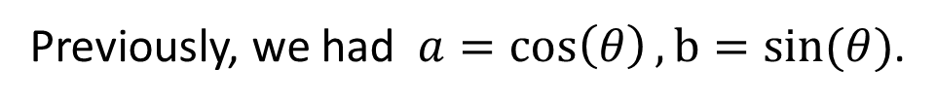








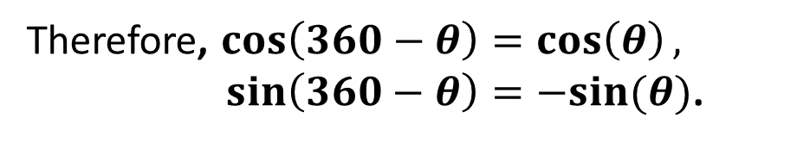
Skill Development
Unit Circle
$$y$$
$$b$$
$$(a,b)$$
$$\cos{(360−θ)}=a ,$$
$$sin\left(360−θ\right)=−b$$
Previously, we had $a=\cos\left(θ\right), b=sin(θ)$.
$$θ°$$
$$a$$
0
$$θ°$$
$$x$$
$$\cos{(360−θ)}=a=cos⁡(θ) ,$$
$$sin\left(360−θ\right)=−b=−sin⁡(θ)$$
$$360°−θ°$$
$$−b$$
$$(a,−b)$$
Therefore, $cos\left(360−θ\right)=\cos\left(θ\right),$ $sin\left(360−θ\right)=−sin(θ)$.

Slide 12

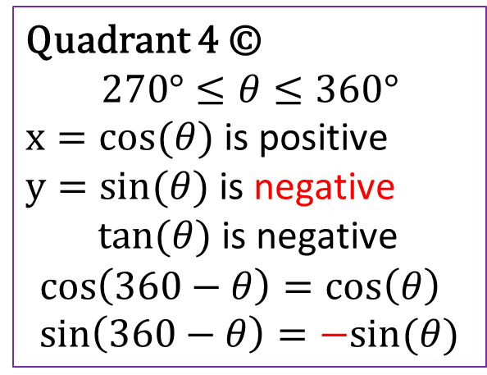

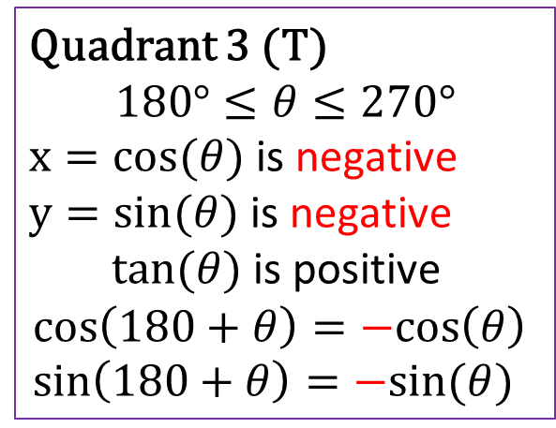
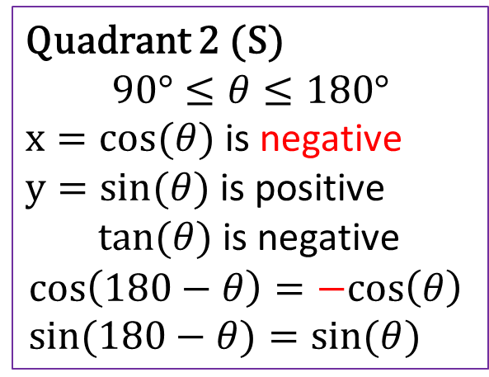
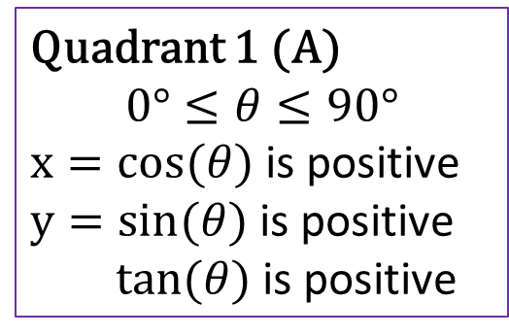
Skill Development
All – Sine – Tangent - Cosine
Quadrant 2 (S)
$$90°≤θ≤180°$$
$x=cos(θ)$ is negative
$y=sin(θ)$ is positive
$tan(θ)$ is negative
$$cos\left(180−θ\right)=−cos\left(θ\right) \\ sin(180−θ)=sin(θ)$$
Quadrant 1 (A)
$$0°≤θ≤90°$$
$x=cos(θ)$ is positive
$y=sin(θ)$ is positive
$tan(θ)$ is positive
$$y$$
Quadrant 2
Quadrant 1
0
$$x$$
Quadrant 3 (T)
$$180°≤θ≤270°$$
$x=cos(θ)$ is negative
$y=sin(θ)$ is negative
$tan(θ)$ is positive
$$cos\left(180+θ\right)=−cos\left(θ\right) \\ sin\left(180+θ\right)=−sin(θ)$$
Quadrant 4 ©
$$270°≤θ≤360°$$
$x=cos(θ)$ is positive
$y=sin(θ)$ is negative
$tan(θ)$ is negative
$$cos\left(360−θ\right)=\cos\left(θ\right) \\ sin\left(360−θ\right)=−sin(θ)$$
Quadrant 3
Quadrant 4

Slide 13





Guided Practice
Unit Circle
$$y$$
Express $\sin\left(240°\right)$ in terms of acute angles.
Quadrant 2
Quadrant 1
Step 1: Determine the quadrant.
Step 2: Find the acute angle.
$$240°$$
$$180°+θ°=240°$$
$$θ°=240°−180°=60°$$
0
$$x$$
Step 3: Determine the signs of sine
Sine is negative
$$sin\left(240°\right)=−sin\left(60°\right)$$
Quadrant 3
Quadrant 4

Slide 14


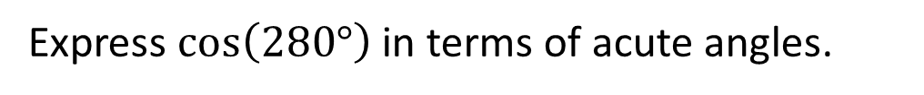


Guided Practice
Unit Circle
$$y$$
Express $\cos\left(280°\right)$ in terms of acute angles.
Quadrant 2
Quadrant 1
Step 1: Determine the quadrant.
Step 2: Find the acute angle.
$$280°$$
$$360°−θ°=280°$$
$$θ°=360°−280°=80°$$
0
$$x$$
Step 3: Determine the signs of cosine
Cosine is positive
$$cos\left(280°\right)=\cos\left(80°\right)$$
Quadrant 3
Quadrant 4

Slide 15


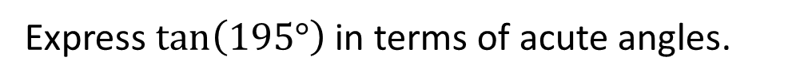


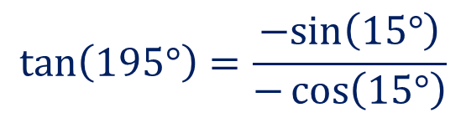
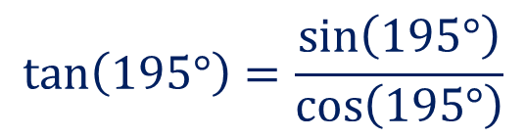
Guided Practice
Unit Circle
$$y$$
Express $\tan\left(195°\right)$ in terms of acute angles.
Quadrant 2
Quadrant 1
Step 1: Determine the quadrant.
Step 2: Find the acute angle.
$$180°+θ°=195°$$
$$195°$$
$$θ°=15°$$
Step 3: Express tan as sin and cos
0
$$x$$
$$tan\left(195°\right)=\frac{\sin\left(195°\right)}{\cos\left(195°\right)}$$
Step 4: Determine the signs of sin and cos
Sine is negative
Cosine is negative
Quadrant 3
Quadrant 4
$$tan\left(195°\right)=\frac{−sin\left(15°\right)}{−\cos\left(15°\right)}$$
$$tan\left(195°\right)=\tan\left(15°\right)$$

Slide 16











Guided Practice
If$sin θ=0.42,\cos{x}=0.7 tan α=0.38 and$ find the following values
$$a) sin\left(π− θ\right)$$
$$=sin⁡(θ)$$
$$y$$
$$=0.42$$
Quadrant 2
Quadrant 1
$$b) cos\left(π+x\right)$$
$$=−cos(x)$$
$$=−0.7$$
0
$$x$$
$$c) tan\left(2π−α\right)$$
$$=−\tan{(α)}$$
$$=−0.38$$
Quadrant 3
Quadrant 4

Slide 17


Guided Practice
If$cos x=−cos\left(\frac{π}{6}\right),\frac{π}{2}<x<π$ find the value of $x$
$$\cos\left(x\right)=−\cos{(π−x)}$$
$$y$$
Quadrant 2
Quadrant 1
$$π−x=\frac{π}{6} \\ x=π−\frac{π}{6} \\ x=\frac{5π}{6}$$
0
$$x$$
Quadrant 3
Quadrant 4

Slide 18


Guided Practice
If$cos x=\cos\left(\frac{π}{6}\right),\frac{3π}{2}<x<2π$ find the value of $x$
$$\cos\left(x\right)=\cos{(2π−x)}$$
$$y$$
Quadrant 2
Quadrant 1
$$2π−x=\frac{π}{6} \\ x=2π−\frac{π}{6} \\ x=\frac{11π}{6}$$
0
$$x$$
Quadrant 3
Quadrant 4

Slide 19



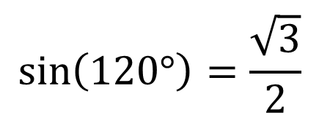
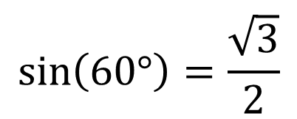
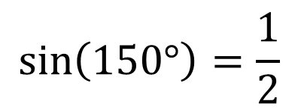

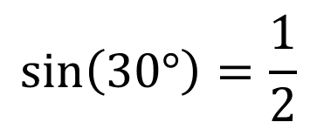
Guided Practice
Evaluate the following in exact values
$$\sin{(120°)} \text{and} sin⁡(150°)$$
Convert to acute angles and determine sign
$$\sin\left(120°\right)=\sin\left(180−120\right)$$
$$\sin\left(150°\right)=\sin\left(180−150\right)$$
$$\sin\left(120°\right)=sin⁡(60°)$$
$$\sin\left(150°\right)=sin⁡(30°)$$
$$\sin\left(60°\right)=\frac{\sqrt{3}}{2}$$
$$\sin\left(30°\right)=\frac{1}{2}$$
$$\sin\left(120°\right)=\frac{\sqrt{3}}{2}$$
$$\sin\left(150°\right)=\frac{1}{2}$$

Slide 20




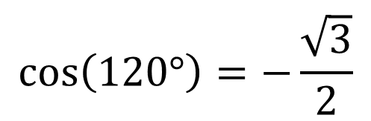
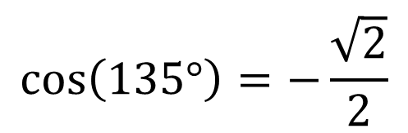
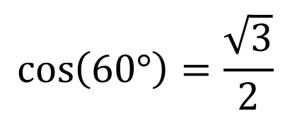
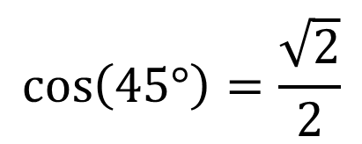
Guided Practice
Evaluate the following in exact values
$$\cos{(120°)} \text{and} cos⁡(135°)$$
Convert to acute angles and determine sign
$$\cos\left(120°\right)=−cos\left(180−120\right)$$
$$\cos\left(135°\right)=−cos\left(180−135\right)$$
$$\cos\left(120°\right)=−cos⁡(60°)$$
$$\cos\left(135°\right)=−cos⁡(45°)$$
$$\cos\left(60°\right)=\frac{\sqrt{3}}{2}$$
$$\cos\left(45°\right)=\frac{\sqrt{2}}{2}$$
$$\cos\left(120°\right)=−\frac{\sqrt{3}}{2}$$
$$\cos\left(135°\right)=−\frac{\sqrt{2}}{2}$$

Slide 21





Guided Practice
Evaluate $\tan\left(135°\right)$ in exact values
Convert to acute angles and determine sign
$$\tan\left(135°\right)=−tan\left(180−135\right)$$
$$\tan\left(135°\right)=−tan⁡(45°)$$
$$\tan\left(45°\right)=1$$
$$\tan\left(135°\right)=−1$$

Slide 22
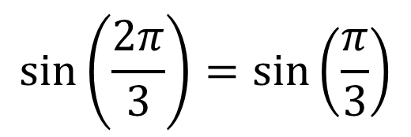
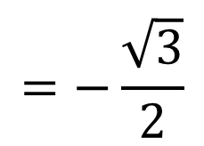
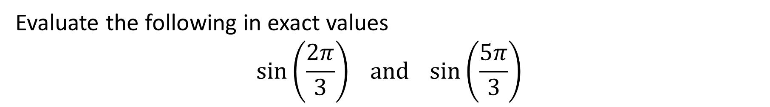
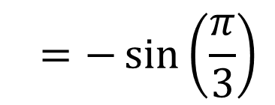
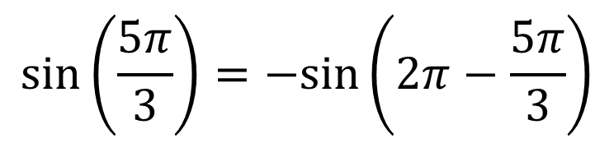
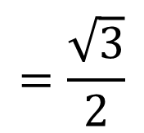
Guided Practice
Evaluate the following in exact values
$$\sin\left(\frac{2π}{3}\right) \text{and} \sin\left(\frac{5π}{3}\right)$$
Convert to acute angles and determine sign
$$\sin\left(\frac{2π}{3}\right)=\sin\left(\frac{π}{3}\right)$$
$$\sin\left(\frac{5π}{3}\right)=−sin\left(2π−\frac{5π}{3}\right)$$
$$=\frac{\sqrt{3}}{2}$$
$${=−\sin\left(\frac{π}{3}\right)}$$
$$=−\frac{\sqrt{3}}{2}$$

Slide 23









Guided Practice
Evaluate the following in exact values
$$\cos\left(\frac{5π}{4}\right) \text{and} \cos\left(\frac{11π}{4}\right)$$
Convert to acute angles and determine sign
$$\cos\left(\frac{11π}{4}\right)=\cos\left(2π+\frac{3π}{4}\right)$$
$$\cos\left(\frac{5π}{4}\right)=\cos\left(π+\frac{π}{4}\right)$$
$$=\cos\left(\frac{3π}{4}\right)$$
$$=−\cos\left(\frac{π}{4}\right)$$
$$=−cos\left(π−\frac{3π}{4}\right)$$
$$=−\frac{\sqrt{2}}{2}$$
$$=−cos\left(\frac{π}{4}\right)$$
$$=−\frac{\sqrt{2}}{2}$$

Slide 24
Independent Practice
Complete Ex 12E & 12F

